Slide 1
Chapter 6:
Programming Languages

Slide 2
Chapter 6: Programming Languages
6.1 Historical Perspective
6.2 Traditional Programming Concepts
6.3 Procedural Units
6.4 Language Implementation
6.5 Object Oriented Programming
6.6 Programming Concurrent Activities
6.7 Declarative Programming
6-<number>

Slide 3
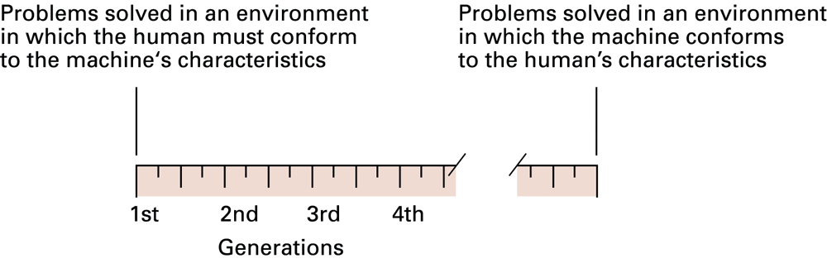
Figure 6.1 Generations of programming languages
6-<number>

Slide 4
Second-generation:
Assembly language
A mnemonic system for representing machine instructions
  Mnemonic names for op-codes
  Program variables or identifiers: Descriptive names for memory locations, chosen by the programmer
6-<number>

Slide 5
Assembly Language Characteristics
One-to-one correspondence between machine instructions and assembly instructions
  Programmer must think like the machine
Inherently machine-dependent
Converted to machine language by a program called an assembler
6-<number>

Slide 6
Program Example
Machine language
156C
166D
5056
30CE
C000
Assembly language
LD R5, Price
LD R6, ShipCharge
ADDI R0, R5 R6
ST R0, TotalCost
HLT
6-<number>

Slide 7
Third Generation Language
Uses high-level primitives
Machine independent (mostly)
Examples: FORTRAN, COBOL
Each primitive corresponds to a sequence of machine language instructions
Converted to machine language by a program called a compiler
6-<number>

Slide 8
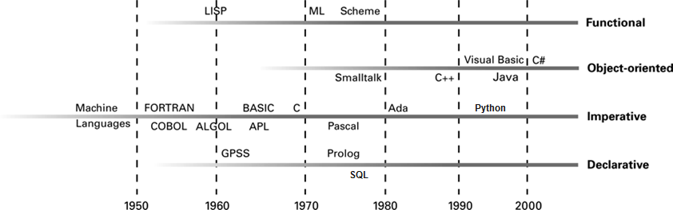
Figure 6.2 The evolution of programming paradigms
6-<number>

Slide 9
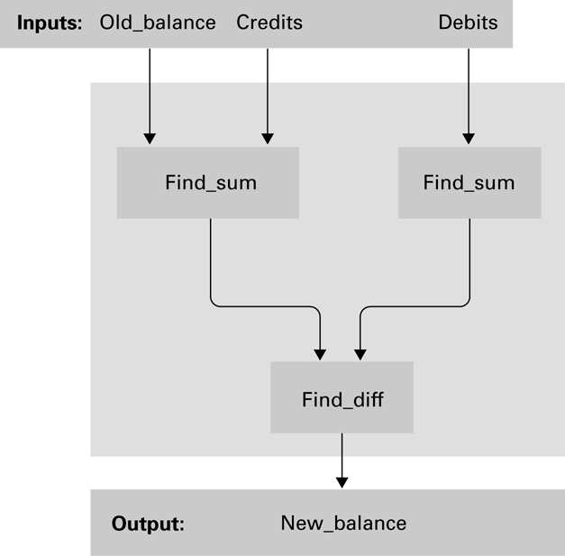
Figure 6.3 A function for checkbook balancing constructed from simpler functions
6-<number>

Slide 10
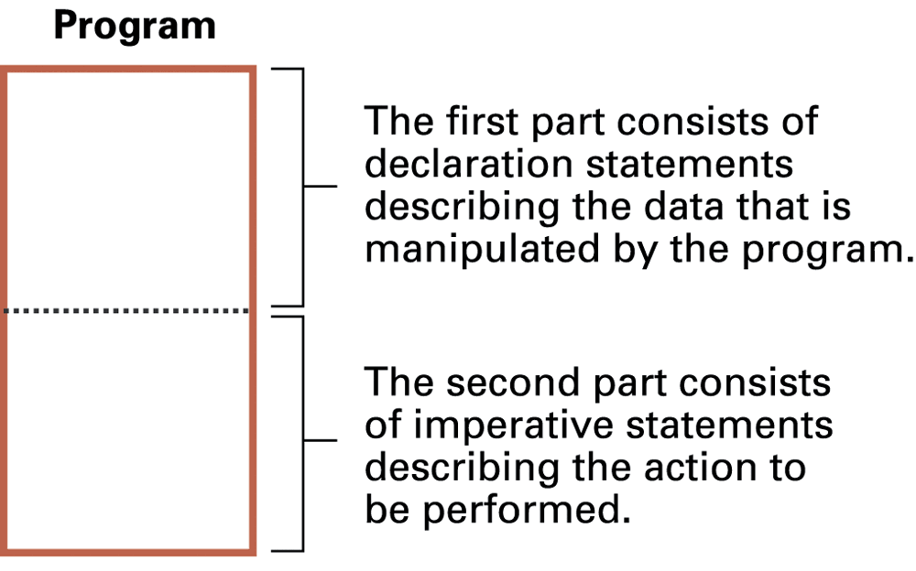
Figure 6.4 The composition of a typical imperative program or program unit
6-<number>

Slide 11
Data Types
Integer: Whole numbers
Real (float): Numbers with fractions
Character: Symbols
Boolean: True/false
6-<number>

Slide 12
Variables and Data types
float Length, Width;
int Price, Total, Tax;
char Symbol;
int WeightLimit = 100;
6-<number>

Slide 13
Data Structure
Conceptual shape or arrangement of data
A common data structure is the array
  In C
  int Scores[2][9];
  In FORTRAN
  INTEGER Scores(2,9)
6-<number>

Slide 14
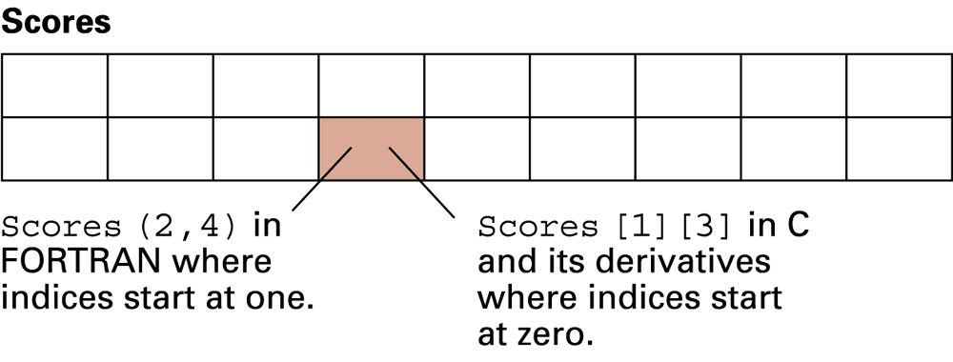
Figure 6.5 A two-dimensional array with two rows and nine columns
6-<number>

Slide 15
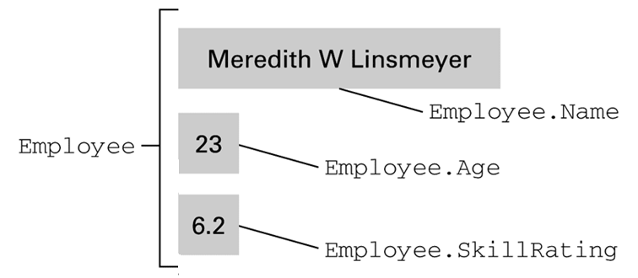
Figure 6.6 The conceptual structure of the aggregate type Employee
struct { char Name[25];
int Age;
float SkillRating;
} Employee;
6-<number>

Slide 16
Assignment Statements
In C, C++, C#, Java
Z = X + y;
In Ada
Z := X + y;
In APL (A Programming Language)
Z ← X + y
6-<number>

Slide 17
Control Statements
Go to statement
goto 40
20 Evade()
goto 70
40 if (KryptoniteLevel < LethalDose) then goto 60
goto 20
60 RescueDamsel()
70 ...
As a single statement
if (KryptoniteLevel < LethalDose):
RescueDamsel()
else:
Evade()
6-<number>

Slide 18
Control Statements (continued)
If in Python
if (condition):
statementA
else:
statementB
In C, C++, C#, and Java
if (condition) statementA; else statementB;
In Ada
IF condition THEN
statementA;
ELSE
statementB;
END IF;
6-<number>

Slide 19
Control Statements (continued)
While in Python
while (condition):
body
In C, C++, C#, and Java
while (condition)
{ body }
In Ada
WHILE condition LOOP
body
END LOOP;
6-<number>

Slide 20
Control Statements (continued)
Switch statement in C, C++, C#, and Java
switch (variable) {
case 'A': statementA; break;
case 'B': statementB; break;
case 'C': statementC; break;
default: statementD; }
In Ada
CASE variable IS
WHEN 'A'=> statementA;
WHEN 'B'=> statementB;
WHEN 'C'=> statementC;
WHEN OTHERS=> statementD;
END CASE;
6-<number>

Slide 21
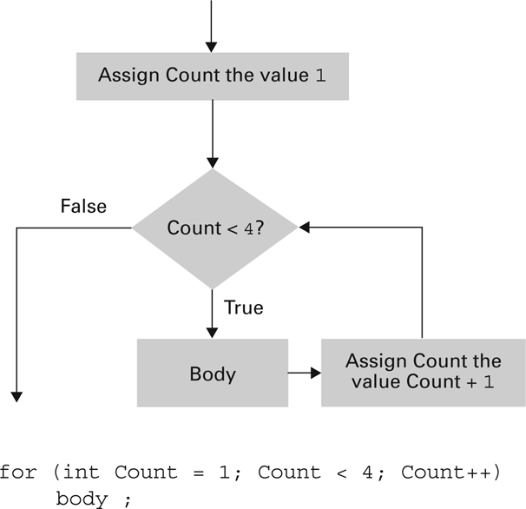
Figure 6.7 The for loop structure and its representation in C++, C#, and Java
6-<number>

Slide 22
Comments
Explanatory statements within a program
Helpful when a human reads a program
Ignored by the compiler
/* This is a comment. */
// This is a comment
6-<number>

Slide 23
Procedural Units
Many terms for this concept:
  Subprogram, subroutine, procedure, method, function
Unit begins with the function’s header
Local versus Global Variables
Formal versus Actual Parameters
Passing parameters by value versus reference
6-<number>

Slide 24
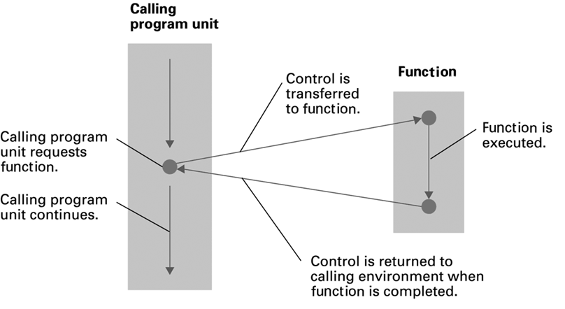
Figure 6.8 The flow of control involving a function
6-<number>

Slide 25
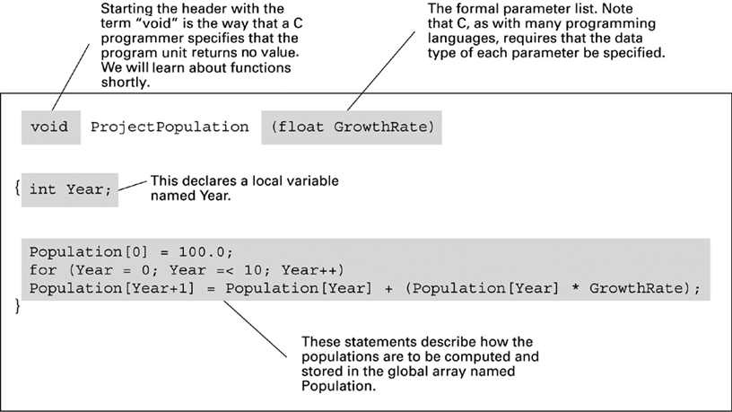
Figure 6.9 The function ProjectPopulation written in the programming language C
6-<number>

Slide 26
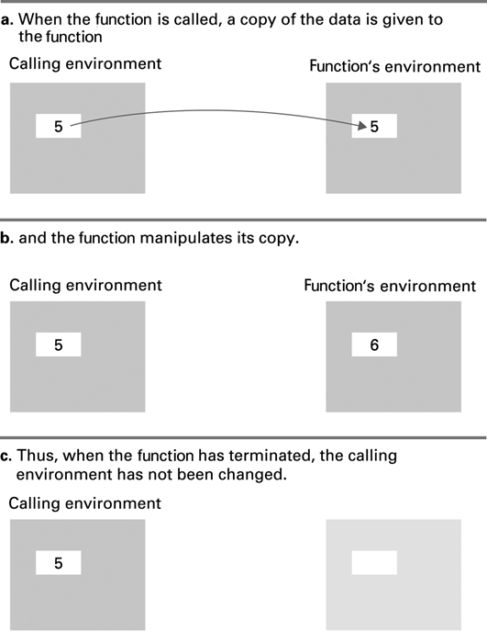
Figure 6.10 Executing the function Demo and passing parameters by value

Slide 27
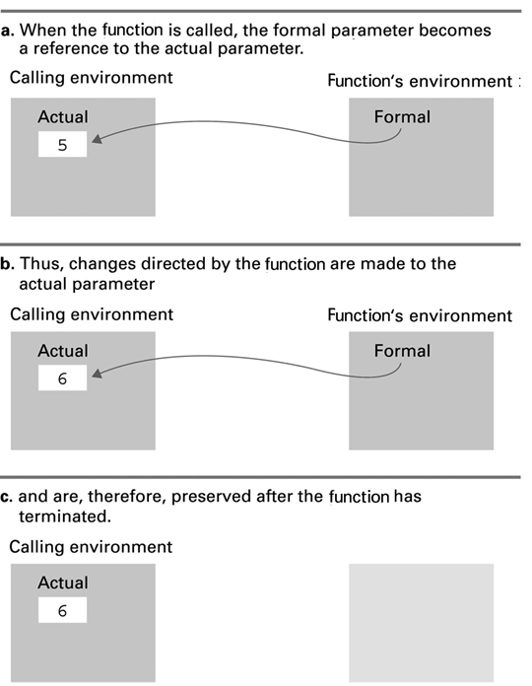
Figure 6.11 Executing the function Demo and passing parameters by reference

Slide 28
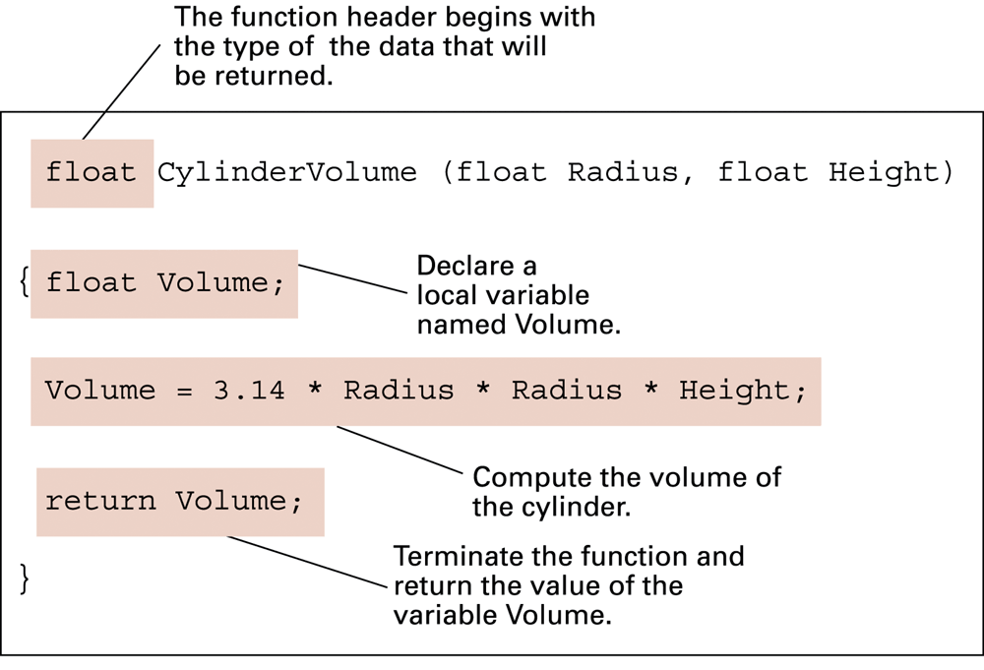
Figure 6.12 The fruitful function CylinderVolume written in the programming language C
6-<number>

Slide 29

Figure 6.13 The translation process
6-<number>

Slide 30
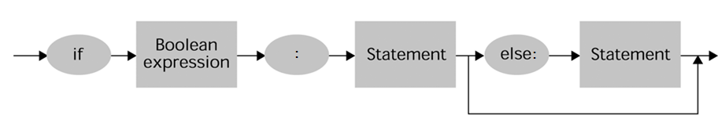
Figure 6.14 A syntax diagram of Python’s if-then-else statement
6-<number>

Slide 31
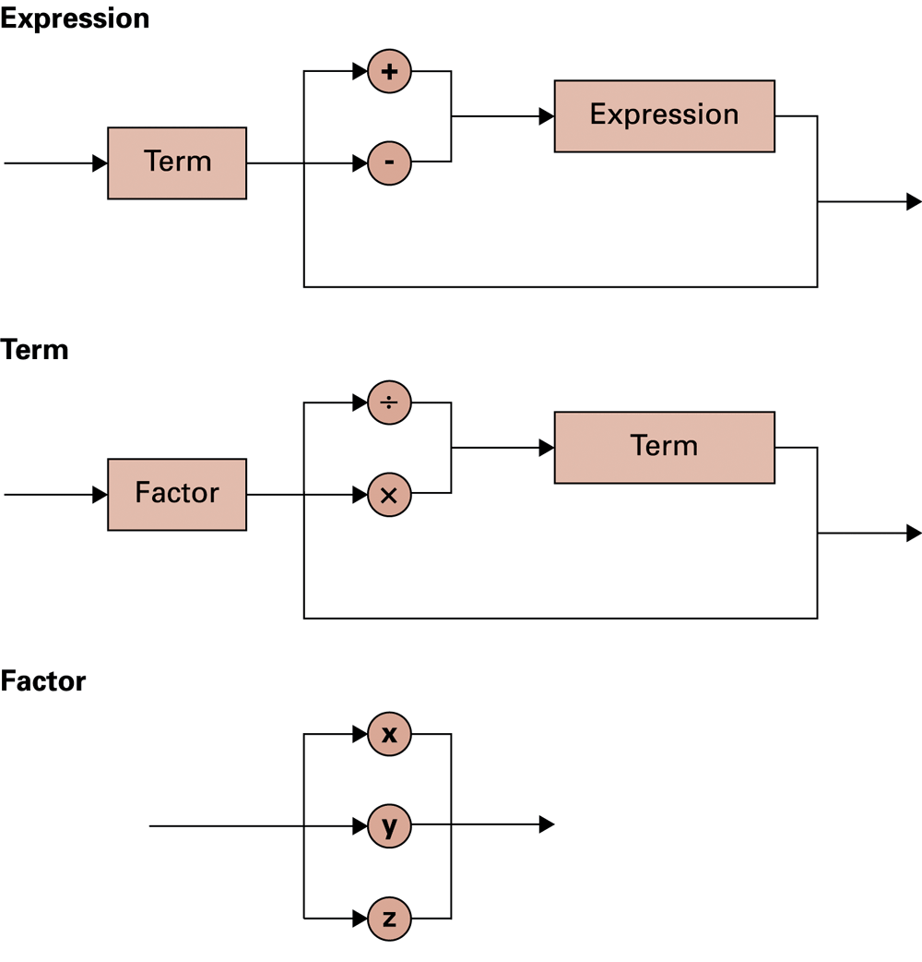
Figure 6.15 Syntax diagrams describing the structure of a simple algebraic expression
6-<number>

Slide 32
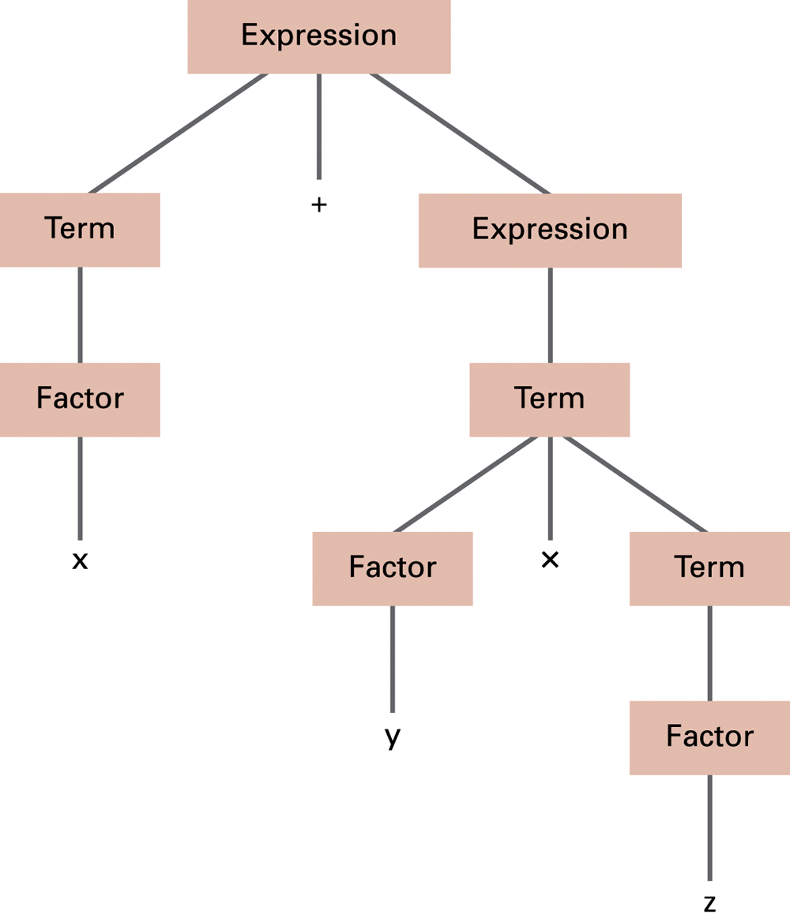
Figure 6.16 The parse tree for the string x + y * z based on the syntax diagrams in Figure 6.17
6-<number>

Slide 33
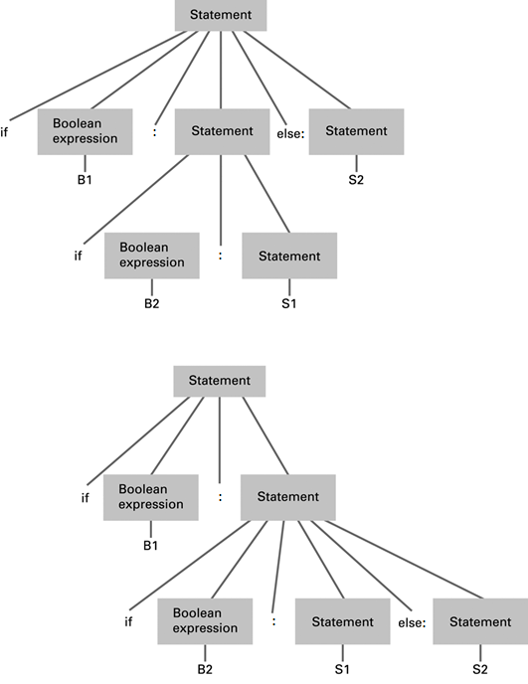
Figure 6.17
Two distinct parse trees for the statement if B1 then if B2 then S1 else S2

Slide 34
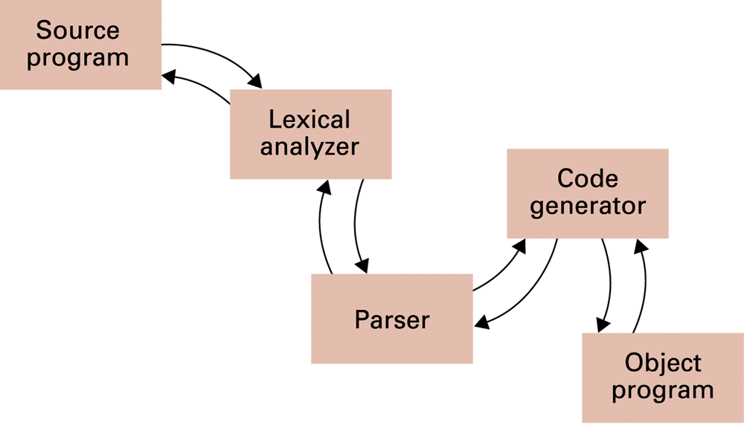
Figure 6.18 An object-oriented approach to the translation process
6-<number>

Slide 35
Objects and Classes
Object: Active program unit containing both data and procedures
Class: A template from which objects are constructed
An object is called an instance of the class.
6-<number>

Slide 36
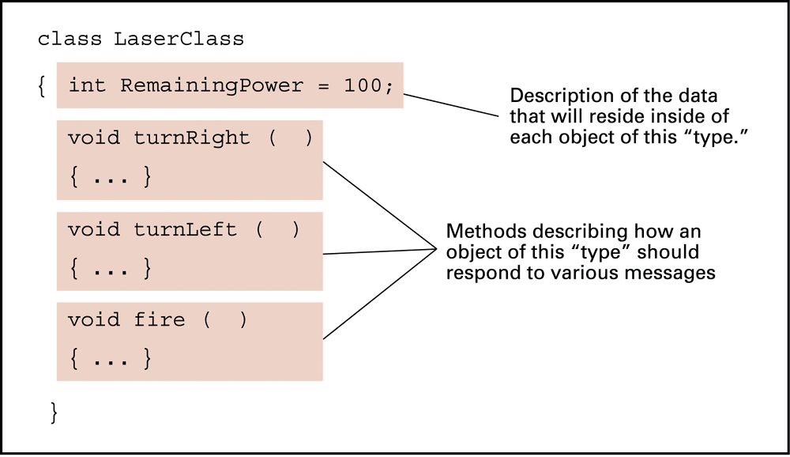
Figure 6.19 The structure of a class describing a laser weapon in a computer game
6-<number>

Slide 37
Components of an Object
Instance Variable: Variable within an object
  Holds information within the object
Method: Procedure within an object
  Describes the actions that the object can perform
Constructor: Special method used to initialize a new object when it is first constructed
6-<number>

Slide 38
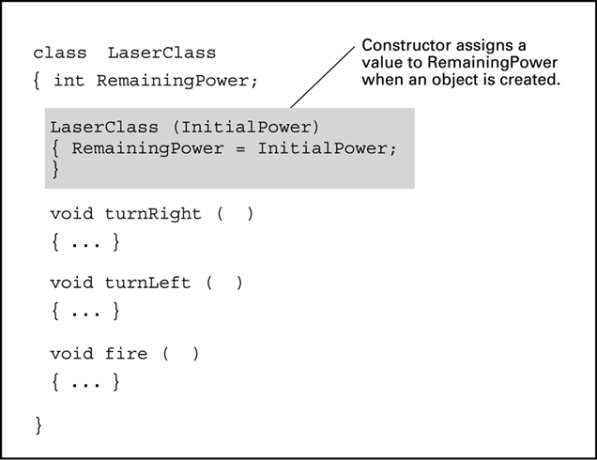
Figure 6.21 A class with a constructor
6-<number>

Slide 39
Object Integrity
Encapsulation: A way of restricting access to the internal components of an object
  Private
  Public
6-<number>

Slide 40
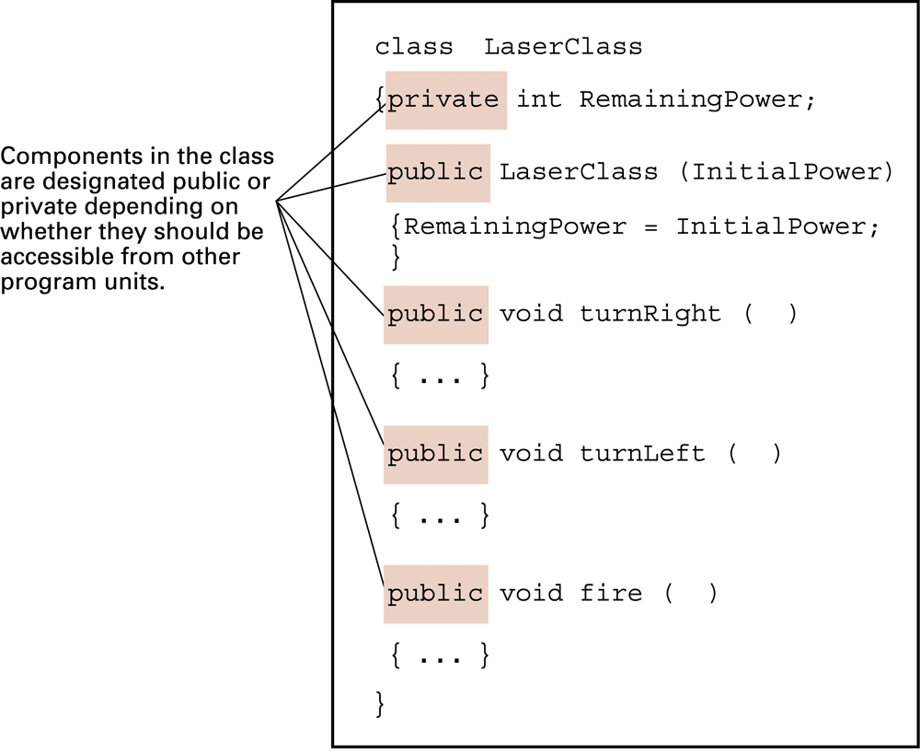
Figure 6.22 Our LaserClass definition using encapsulation as it would appear in a Java or C# program
6-<number>

Slide 41
Additional Object-oriented Concepts
Inheritance: Allows new classes to be defined in terms of previously defined classes
Polymorphism: Allows method calls to be interpreted by the object that receives the call
6-<number>

Slide 42
Programming Concurrent Activities
Parallel (or concurrent) processing: simultaneous execution of multiple processes
  True concurrent processing requires multiple CPUs
  Can be simulated using time-sharing with a single CPU
6-<number>

Slide 43
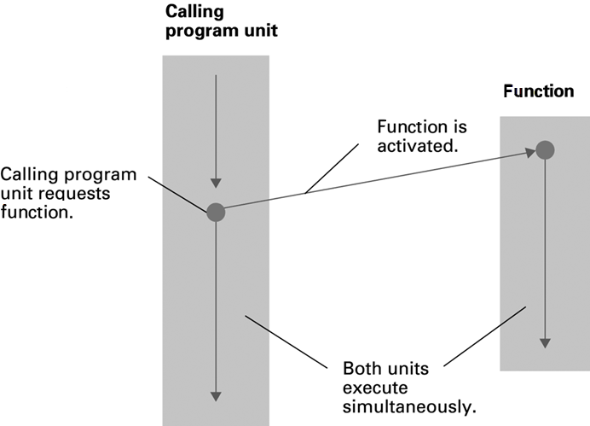
Figure 6.23 Spawning threads
6-<number>

Slide 44
Controlling Access to Data
Mutual Exclusion: A method for ensuring that data can be accessed by only one process at a time
Monitor: A data item augmented with the ability to control access to itself
6-<number>

Slide 45
Declarative Programming
Resolution: Combining two or more statements to produce a new statement (that is a logical consequence of the originals).
  Example: (P OR Q) AND (R OR ¬Q)
  resolves to (P OR R)
  Resolvent: A new statement deduced by resolution
  Clause form: A statement whose elementary components are connected by the Boolean operation OR
Unification: Assigning a value to a variable so that two statements become “compatible.”
6-<number>

Slide 46
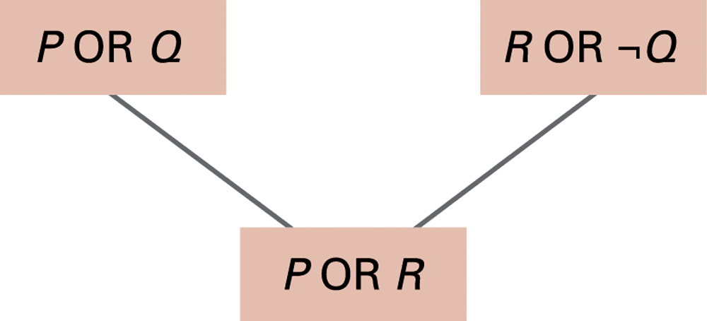
Figure 6.24 Resolving the statements (P OR Q) and (R OR ¬Q) to produce (P OR R)
6-<number>

Slide 47
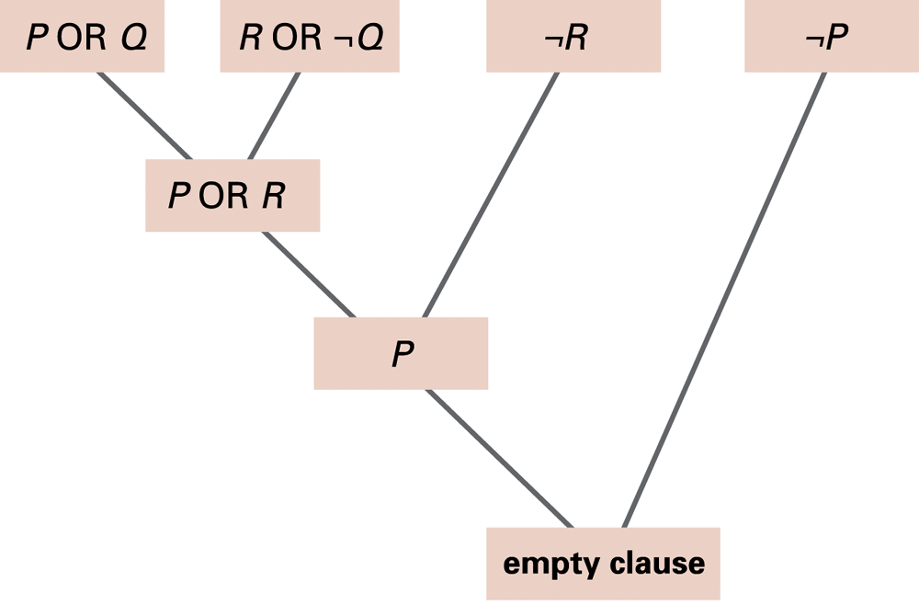
Figure 6.25 Resolving the statements (P OR Q), (R OR ¬Q), ¬R, and ¬P
6-<number>

Slide 48
Prolog
Fact: A Prolog statement establishing a fact
  Consists of a single predicate
  Form: predicateName(arguments).
    Example: parent(bill, mary).
Rule: A Prolog statement establishing a general rule
  Form: conclusion :- premise.
    :- means “if”
  Example: wise(X) :- old(X).
  Example: faster(X,Z) :- faster(X,Y), faster(Y,Z).
6-<number>

Slide 49
End
of
Chapter

